Slide 1
SIGTRAN
Overview

Slide 2
CONTENTS
CONTENTS
Introduction
Why Using Sigtran
Problem With SS7
Problem with TCP
Architecture
Protocols
<number> of 19

Slide 3
INTRODUCTION
Sigtran is a working group of the IETF, formed in 1999, and tasked with defining an architecture for the transport of real-time signaling data over IP networks. Its work culminated in not just the architecture, but also the definition of a suite of protocols to carry SS7 and ISDN messages over IP.
This protocol suite is made up of a new transport layer -- the Stream Control Transmission Protocol (SCTP) -- and a set of User Adaptation (UA) layers which mimic the services of the lower layers of SS7 and ISDN.
<number> of 19

Slide 4
This article describes the Sigtran architecture and protocol suite. It starts by outlining the network architecture within which the Sigtran suite applies, effectively defining the problem solved by SCTP and the UAs. It continues to describe the protocol requirements for transporting signaling information over IP
Sigtran is a SS7 over IP. It is used for transport of real time signaling data over IP network.
This is a standard defines the procedures and protocol by which network elements in the public switched telephone network (PSTN) exchange information over a IP network to effect wireless (cellular) and wire line call setup, routing and control.
<number> of 19

Slide 5
Reasons to Deploy Sigtran
SLS Load Sharing
Single Link-Set
Scalable Network
Fewer Network elements
5. Cost
<number> of 19

Slide 6
What’s wrong with TCP for transport of signaling?
HOL Blocking :Two network nodes signal at the same time about many independent calls.TCP ties them together-one lost message concerning a single call causes signaling of other calls to halt until retransmission recovers the lost message.
TCP is byte stream oriented -application needs to add its own message delimiters and push operations.
TCP does not allow multi-homing -does not reach the required level of reliability( UDP is even more unreliable).
Applications cannot control TCP timers -signaling delay requirements are difficult to meet when TCP uses retransmission.

Slide 7
Interface Between PSTN and IP Networks For Voice
IP Network
MGC
MGC
SIGTRAN
SIGTRAN
SS7
SG
IP Phone
SG
SS7
IP SCP
Voice
Voice
MG
MG
<number> of 19

Slide 8
The Following Network Elements are defined
MGC --Media Gateway Controller, responsible for mediating call control (between the SG and MG) and controlling access from the IP world to/from the PSTN.
SG -- Signaling Gateway, responsible for interfacing to the SS7 network and passing signaling messages to the IP nodes.
MG -- Media Gateway, responsible for packetization of voice traffic and transmitting the traffic towards the destination.
IP SCP --an IP-enabled Service Control Point (SCP). This exists wholly within the IP network, but is addressable from the SS7 network.
The IP Phone (generically referred to as a ‘terminal’).
<number> of 19

Slide 9
Overview Of SIGTRAN Protocol Architecture
The Architecture define by SIGTRAN work group consist of 3 component
A standard IP.
A common signaling transports protocol
A transport protocol support a common set of reliable transport functions for signaling transport In particular SCTP is a new transport protocol that has been defined by the IETF
3 An Adaption sub layer
Several new adaption sub layer protocols have been defined
by the IETF: M2UA,M2PA,M3UA,SUA and IUA.
<number> of 19

Slide 10
SIGTRAN Protocol Concepts
All *UA are asymmetric.
M2PA is something like a symmetric IP-based MTP-2 link.
The *UA use a cluster concept to handle host failures with similar messages.
M3UA is the protocol mostly deployed.
All adaptation layers use the same transport protocol for reliable message transfer.

Slide 11
Architecture Of Sigtran
TCAP
SCCP
MTP 3
ISDN
M3UA
M2UA
M2PA
SUA
IUA
SCTP
IP
<number> of 19

Slide 12
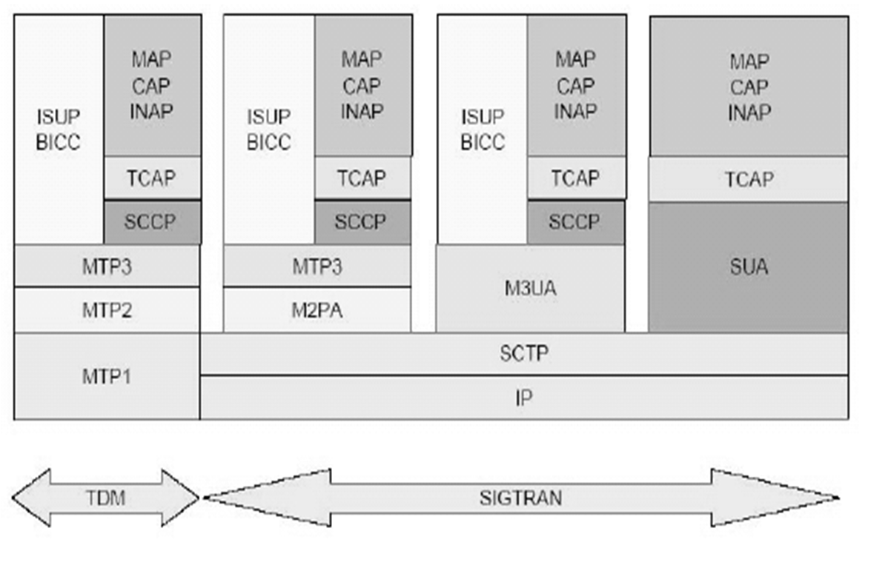
Comparison with SS7
<number> of 19

Slide 13
SCTP Features
Multi-streaming (Chunking): Allows for multiple virtual connections on the same physical line. Each user application might be assigned its own stream (virtual connection). SCTP multi-streaming allows data to be delivered in multiple, independent streams, so that if there is data loss in one stream, delivery will not be affected for the other streams
Sequenced Delivery: Allows for messages to be delivered in the order in which there were sent.
Block-Level: Unlike TCP in which transmission is viewed as a continuous stream of data, SCTP transmits blocks.
Self-Fragmentation: SCTP uses MTU path discovery to ensure that messages are not fragmented by intermediate nodes.

Slide 14
It is a Uni-cast Protocol - data exchange is between two known endpoints.
It provide reliable transport of data - detecting when data is corrupt or out of sequence, and performing repair as necessary.
It is message-oriented, defining structured frame of data, on the other hand, TCP imposes no structured on the transmitted stream of bytes.
It support Multi-Homing - Each SCTP endpoint may be known by multiple IP addresses. Routing to one address is independent of all others, & if one route fails, another will be used.
It is Rate-Adaptive, responding to network congestion.
Responsible for packet retransmission when timely acknowledgement has not been received.

Slide 15
Checksums , acknowledgements and message numbering ( in streams)
Detection of lost ,corrupted and duplicated packets,
selective retransmission.
Congestion control for associations.
Many streams (of packets) within an association.
Multihoming (hosts with n IP addresses)
SCTP is a general purpose protocol, a replacement for TCP.
Reliable transport of messages across a possibly unreliable network service such as IP.
Aim of designing SCTP is to address the Shortcomings of TCP.
It uses an initialization procedure, based on cookies, to prevent denial-of-service attacks.

Slide 16
SCTP association
An association is initiated by a request from the SCTP user.
SCTP provides for graceful close of an active association. On request from the SCTP user.
The connection between two nodes is called an SCTP association and can consist of multiple paths through an IP network.
SCTP end points composed of the two SCTP end points and protocol state information.
Two SCTP end points must not have more than one SCTP association between them at any given time.

Slide 17
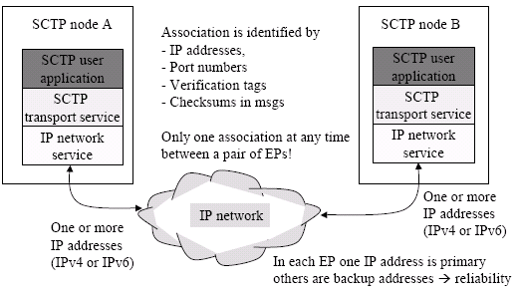
An SCTP association looks like this

Slide 18
SCTP end point
An SCTP end point is the logical sender/receiver of SCTP packets.
It comprises of a set of transport addresses, which is a combination of IP addresses and port numbers.
Transport address is unique to an SCTP end point.
SCTP end point must not use a transport address used by another SCTP end point.

Slide 19
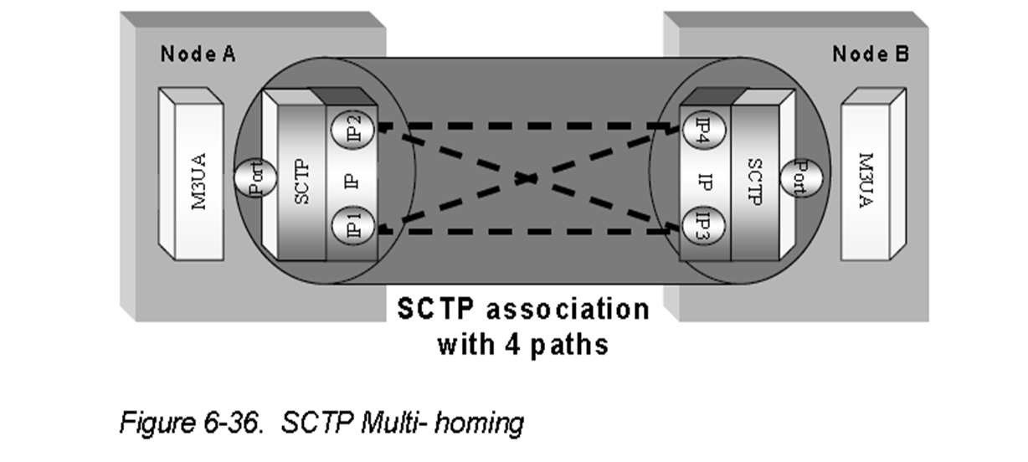
SCTP Multi- homing
Multi-homing feature, which allows each SCTP end point to use multiple IP addresses for each association.

Slide 20
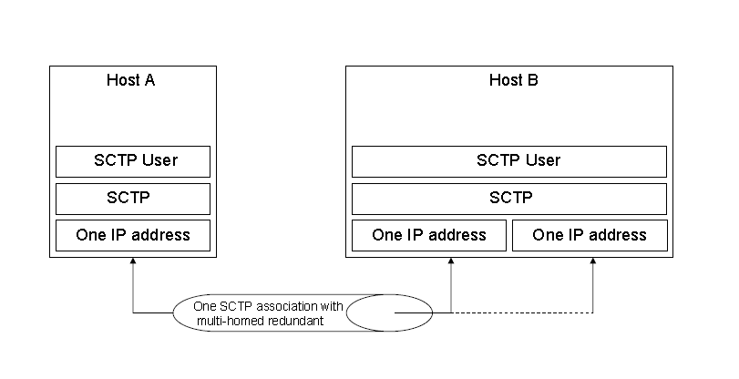
SCTP Multi- homing
An SCTP end point is considered multi-homed if it has more than one transport address that can be used as a destination address (DA) to reach that end point.

Slide 21
SCTP transport address
In Network layer address and transport layer port number define a transport address.
the case of SCTP running over IP, a transport address is defined by the combination of an IP address and an SCTP port number (SCTP is the transport protocol).

Slide 22
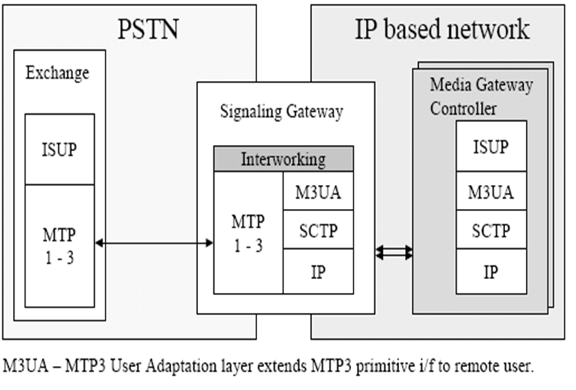
A use case : Signaling Gateway

Slide 23
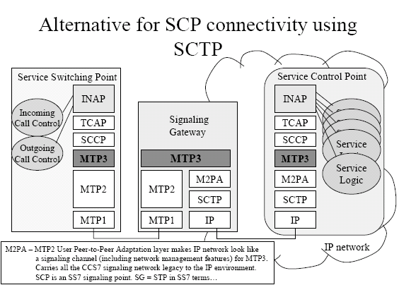

Slide 24
M3UA Architecture
Media Gateway
Media Gateway Controller
NIF
ISUP
MTP3
M3UA
M3UA
MTP2
SCTP
SCTP
MTP1
IP
IP
SS7 LINKS
<number> of 19

Slide 25
M3UA provides a means by which an MTP3 service may be provided on an MGC (thus, terminating the ISUP connection on the MGC)-essentially extending the reach of SS7 into the IP network.
The M3UA layer is responsible for maintaining the MTP3-ISUP interface across an SCTP connection.
Commands and requests for data transfer passed down by ISUP on the MGC are carried by M3UA and presented to the upper interface of MTP3 on the SG.
Indications and incoming data messages are passed up from MTP3 on the SG and carried by M3UA to the lower interface of ISUP on the MGC.

Slide 26
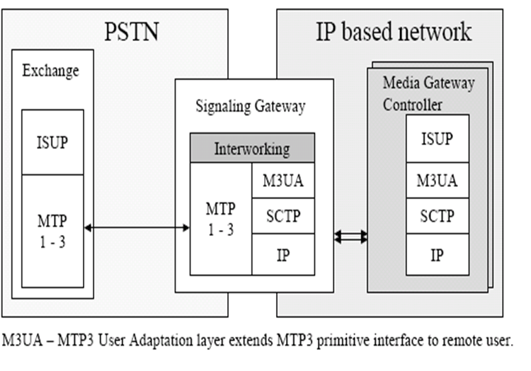
Signaling Gateway can use M3UA

Slide 27
M2UA Architecture
Signaling Gateway
Media Gateway Controller
NIF
MTP3
M2UA
MTP2
M2UA
SCTP
SCTP
MTP1
IP
IP
SS7 Links
<number> of 19

Slide 28
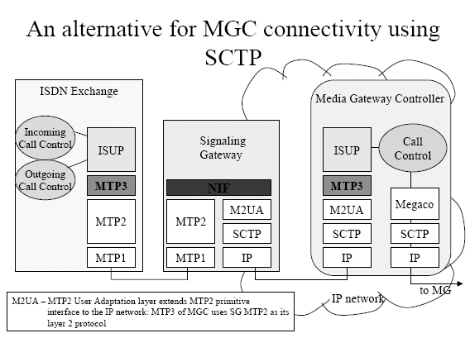
<number> of 19

Slide 29
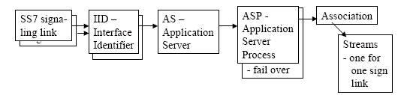
M2UA extends MTP2 primitive interface to a remote system
<number> of 19

Slide 30
Each signaling link has IID-Interface Identifier.
Messages from many signaling links can be sent to one AS.
M2UA manages AS fail over.
Each signaling link is mapped to its own stream in one association , thus messages from different links can be treated in different sequences.
M2UA provides the services of MTP2 in a client-server situstion, such as SG to MGC.Its user would be MTP3.

Slide 31
M2PA Architecture
Signaling Gateway
Signaling Gateway
MTP 3
MTP 3
MTP 2
M2PA
M2PA
MTP2
SCTP
SCTP
MTP1
MTP1
IP
IP
SS7 LINKS
SS7 LINKS
<number> of 19

Slide 32
M2PA is responsible for:
Link activation/deactivation (in response to requests from MTP3)
Maintaining link status information.
Maintaining sequence numbers and retransmit buffers, for retrieval by MTP3.
Maintaining local and remote processor outage status.
Provides a means for peer MTP3 layers in SGs to communicate directly .

Slide 33
SUA supports the following
Transfer of SCCP-User Part messages(TCAP,RANAP, etc.)
Emulation of SCCP connectionless and connection oriented service.
Seamless operation of SCCP-User protocol peers.
Management of SCTP transport associations between an SG and one or more IP-based signaling nodes.
Asynchronous reporting of status changes to management.

Slide 34
Thank you

